Slide 1



AN INCONVENIENT TRUTH:
Artificial Intelligence in General Practice
Dr Ben Lees | GP Partner & Digital Fellow | Greener Practice

Slide 2

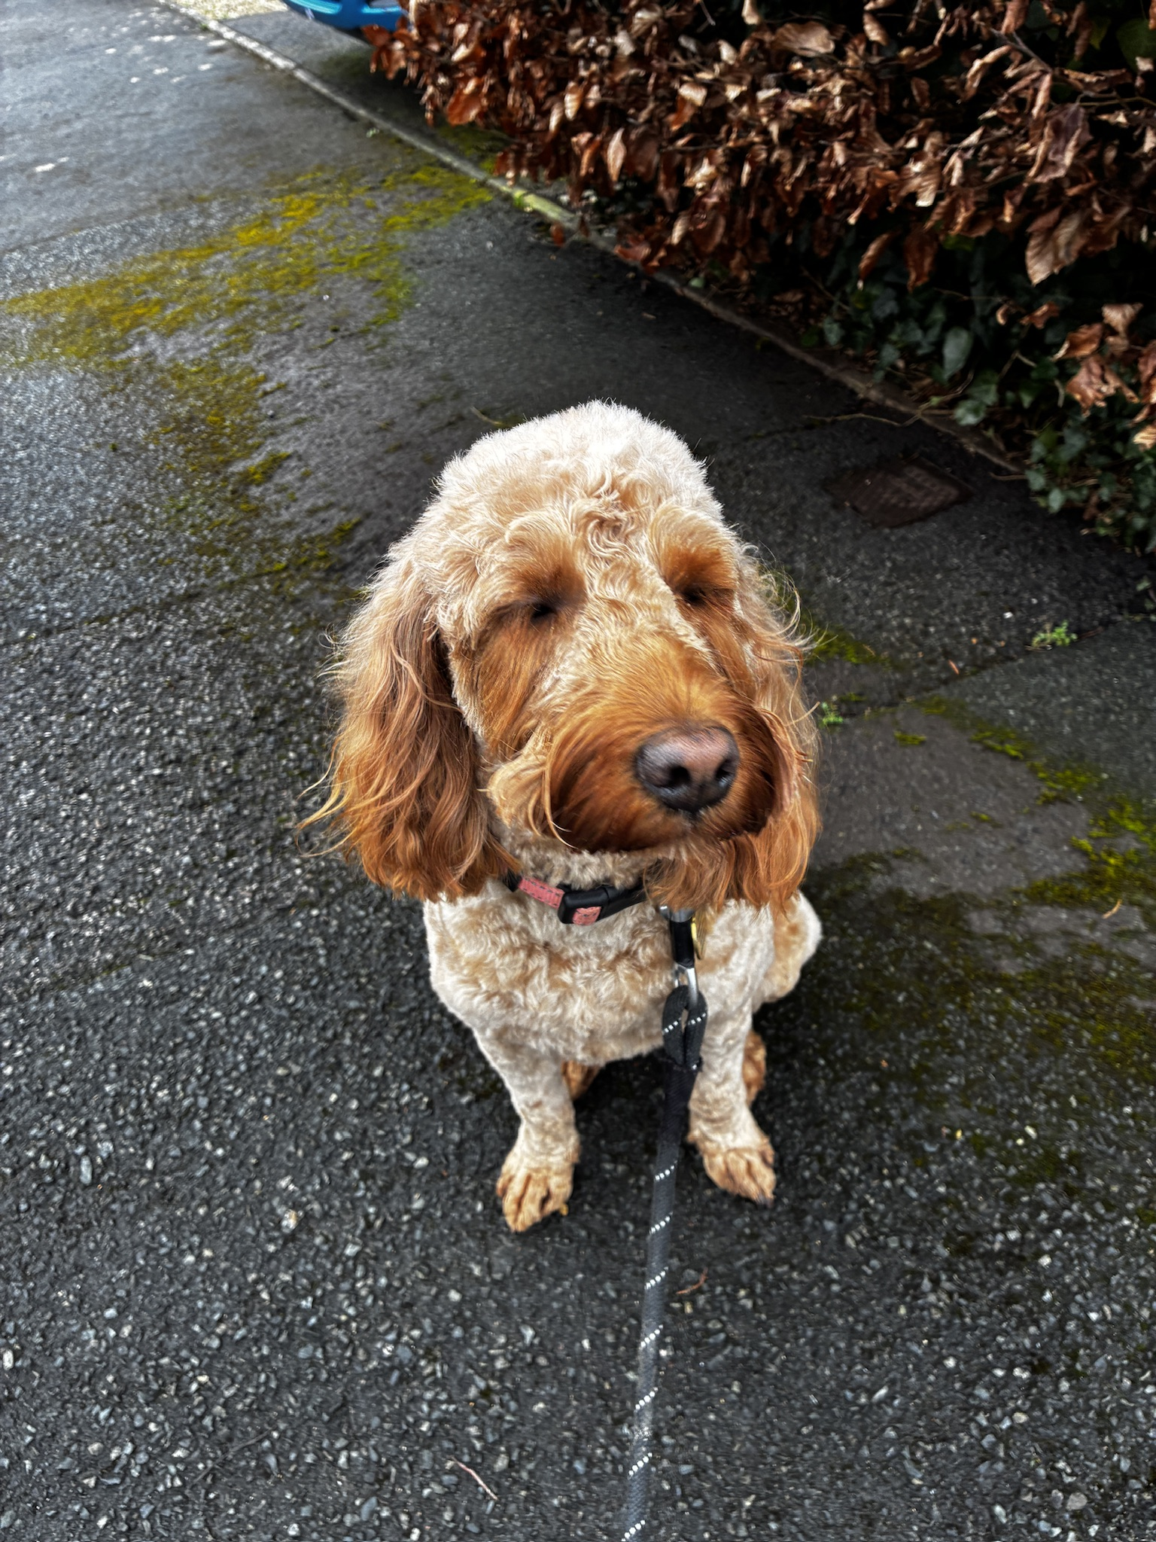
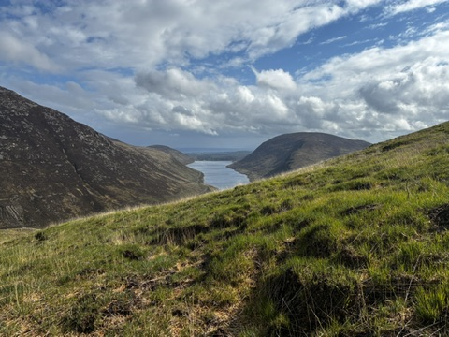
About me
🩺
Full-time GP Partner, The Leckhampton Surgery
🎓
GP Trainer & Mentor
🌱
NHSE Fellowships, Sustainable Primary Care (2020) and AI in General Practice (2025)
Husband, father and fur-parent to Nala!
I am a doctor with an interest — not an AI or sustainability expert.
I’m not an AI evangelist either- I’d rather be walking my dog in the hills!

Slide 3
Before we start —
what do YOU want
to get out of today?
Speak up and I’ll do my best!
🤔
Something you're
curious about AI
⚠️
Something you're
concerned about
🛠️
Something practical
you want to take away

Slide 4


WHAT WE ACTUALLY USE IN PRACTICE
Microsoft Copilot
Heidi (AVT)
Drafting communications & policy documents
Summarising meeting notes
Back-office admin & governance work
NHS Enterprise Copilot: data stays within NHS
MHRA Class 1 registered ambient transcription
Listens · strips PID · generates structured note
Reclaims 1–2 hours per clinician per week
Safe two-step workflow for clinical AI use
Getting from 'we want to use this' to 'we use it safely' took real governance work.

Slide 5
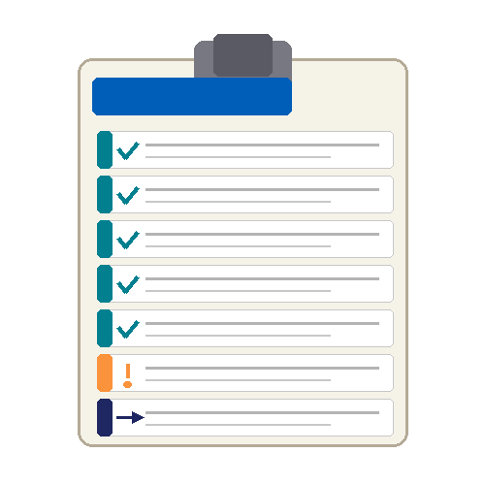
IMPLEMENTATION: THE REAL WORK
✓
Data Processing Agreement review
✓
MHRA registration check (Class 1 ✓)
✓
Data Protection Impact Assessment (DPIA)
✓
Patient consent protocols established
✓
Team training: safe use & limitations
✓
Policy for patient declining consent
!
Ongoing literacy support for the team
→
Governance = first. Technology = second.

Slide 6
WHERE AI COULD GENUINELY HELP
🎙️
Ambient Transcription
📝
📊
IN USE
Referral Letters
IN USE
Admin & Governance
IN USE
Voice-to-notes during consultations. Less screen time, more patient contact. Reclaims 1–2 hrs/week.
I dictate to the AI during or after the consultation. It drafts the letter. Faster than dictating myself — and it handles the structure.
Policy drafting, meeting summaries, committee papers. Copilot earns its keep here. GP partners: take note.
📋
Summarising Records
💊
🔍
POTENTIAL
Drug Interaction Screening
POTENTIAL
Decision Support
POTENTIAL
AI could read a 15-year patient record and surface what's relevant in seconds. Not yet deployed — but the potential is real.
AI could flag complex polypharmacy interactions faster than current tools. Compelling potential for clinical pharmacists.
Risk stratification, differential thinking, safety-netting. Promising — but needs robust evidence and careful clinical oversight.

Slide 7
HONEST ABOUT LIMITATIONS
⚠ What AI does BADLY
✔ What you must NEVER outsource
Hallucinations — fluent, confident, wrong
Clinical judgment & contextual nuance
Gut feelings & safeguarding instincts
Bias: performs worse on underrepresented groups
Homogenising clinical thinking across a profession
Knowing what it doesn't know
Final clinical decision-making
Reading AI output before acting on it
Recognising when the tool is wrong
Patient-facing communication & empathy
Professional accountability & responsibility
Safeguarding judgement
"The AI told me" is not a clinical defence. It never has been. It never will be.

Slide 8

THREE NON-NEGOTIABLE SAFETY RULES
Never put PID into a commercial LLM
01
Patient identifiable data into ChatGPT, Copilot or Gemini is a GDPR breach. Use Heidi to strip PID first. Use NHS Enterprise Copilot for the clean output.
You own every AI output
02
If AI writes your referral letter, you read it and you sign it. If AI generates a clinical note, it's yours. No exception. No defence.
Beware prompt injection attacks
03
Malicious content in emails or documents can manipulate AI systems into leaking data or taking unauthorised actions. EchoLeak (2025): Copilot exploited through a malicious email — no user interaction needed.
ECRI Institute: AI is the #1 health technology hazard for 2025. 92% of healthcare organisations reported AI-related attacks in 2024.

Slide 9
THE INCONVENIENT TRUTH: AI'S ENVIRONMENTAL COST
est. up to
est. up to
already
80M
765B
4×
tonnes CO₂ in 2025
litres of water in 2025
all UK homes' electricity
Up to 20% of the UK's
Enough for ~15 million
That's 2024 figures.
entire annual emissions
UK people for a full year
By 2030: up to 9×
All ~35 million UK cars
Up to 300,000
415 TWh (2024) →
driven for two years
Olympic swimming pools
est. up to 945 TWh (2030)
🔊 ALSO:
Noise: data centres produce ~70–80 dB — equivalent to a motorway. Water: a single large data centre can use as much as a town of 50,000 people. Land: multiple centres sited in water-scarce regions, competing with agriculture.

Slide 10
THE TRANSPARENCY GAP
✓ What companies DO report
✗ What companies DON'T report
Company-wide electricity consumption
Total water use (direct cooling only)
Aggregate CO₂ commitments
Net-zero pledges (Google, Microsoft: 2030)
AI-specific energy consumption
Indirect water use from electricity generation (3-4× higher than direct)
Per-query carbon or water cost
% of data centre capacity used for AI
Energy efficiency of individual facilities
Stanford study: OpenAI, Google, Amazon, Anthropic — none disclose adequate environmental data. If we can't measure it, we can't manage it.

Slide 11
IT'S NOT THAT SIMPLE: NET ENVIRONMENTAL IMPACT
🎙️ Voice Transcription
Without AI: 90 min/day extra admin · burnout · reduced patient contact · delayed appointments
AI cost: Small, bounded inference per consultation
Verdict: Probably NET POSITIVE
💊 Drug Interaction Screening
Without AI: Risk of missed interaction · hospital admission · much larger environmental footprint
AI cost: Minimal computation to screen a medication list
Verdict: Probably NET POSITIVE
🎲 Frivolous AI Use
Without AI: You'd just… not do it. No benefit was gained. No inefficiency was removed.
AI cost: Real energy, real water, every query
Verdict: NET NEGATIVE — resource waste
The question is not 'Is AI sustainable?' — it's 'Is THIS use worth the cost?'

Slide 12
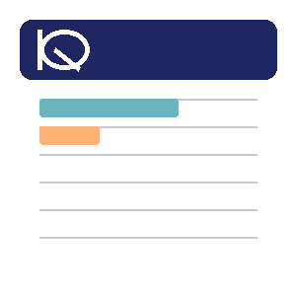
USE AI LIKE YOU PRESCRIBE MEDICATION
Lowest dose necessary to achieve the therapeutic goal. Apply the same logic to AI.
1
2
3
4
5
Is there a real problem?
What's the genuine alternative?
Is the net impact positive?
Use the lowest powered tool
Don't use it recreationally
Not curiosity. Not novelty. A genuine recurring problem that costs time or clinical quality.
Manual work? Delegation? Nothing? If the honest answer is 'I'd manage fine' — maybe skip it.
Does time saved outweigh resource cost? Does clinical benefit justify the footprint?
GPT-4 uses far more energy than a smaller model. If GPT-3.5 does the job — use GPT-3.5.
Every query costs energy and water. Casual, frivolous use is waste. Be intentional.

Slide 13
WHO IS RESPONSIBLE FOR WHAT?
Tech Companies
▸ Mandatory disclosure of AI-specific emissions
▸ Site data centres in low-carbon, low-water-stress regions
▸ Invest in renewables that outpace AI growth
▸ Develop more efficient models — stop the arms race
Regulators & Policy
▸ Mandate transparency disclosures
▸ Carbon pricing that reflects true cost
▸ Environmental impact assessments for data centres
Healthcare Organisations
▸ Build environmental impact into procurement criteria
▸ Demand vendor transparency contractually
Us — Clinicians & Managers
▸ Use thoughtfully, not casually
▸ Ask vendors hard questions
▸ Choose NHS-approved routes where possible

Slide 14
WHY NOW MATTERS: EXPONENTIAL GROWTH
945
24–44M
extra tonnes CO₂/year by 2030
= 5–10 million additional cars
750
590
73%
potential carbon reduction
with smart siting + renewables
415
250
86%
potential water reduction
with efficiency + grid changes
2022
2024
2026*
2028*
2030*
Data centre electricity demand (TWh)
* Projected | The infrastructure choices made this decade determine AI's climate trajectory.

Slide 15
THREE THINGS YOU CAN DO THIS WEEK
1
2
3
Have the team conversation
Use AI mindfully
Try Copilot — today
Not about restriction — about intentionality. When should we use AI? When should we not? What problem are we actually solving? Thirty minutes at your next team meeting.
Before you reach for an AI tool, ask: Is there a real problem here? What would I do without it? Am I using the lowest-powered tool for the job? Five seconds of reflection before every query.
If you have a Microsoft 365 account, you already have access. Open Teams or go to copilot.microsoft.com in your browser. Ask it to draft something simple. See what it can do.
Time needed: 30 minutes
Takes: 5 seconds of thought
Try it: copilot.microsoft.com

Slide 16
We need
Sound clinical judgement
In the AI conversation
Look for the evidence-base. Risk-benefit awareness. Being honest about uncertainty.
Profits must serve patients and the planet.
Dr Ben Lees | GP Partner & Digital Fellow | ben.lees@nhs.net

Slide 17
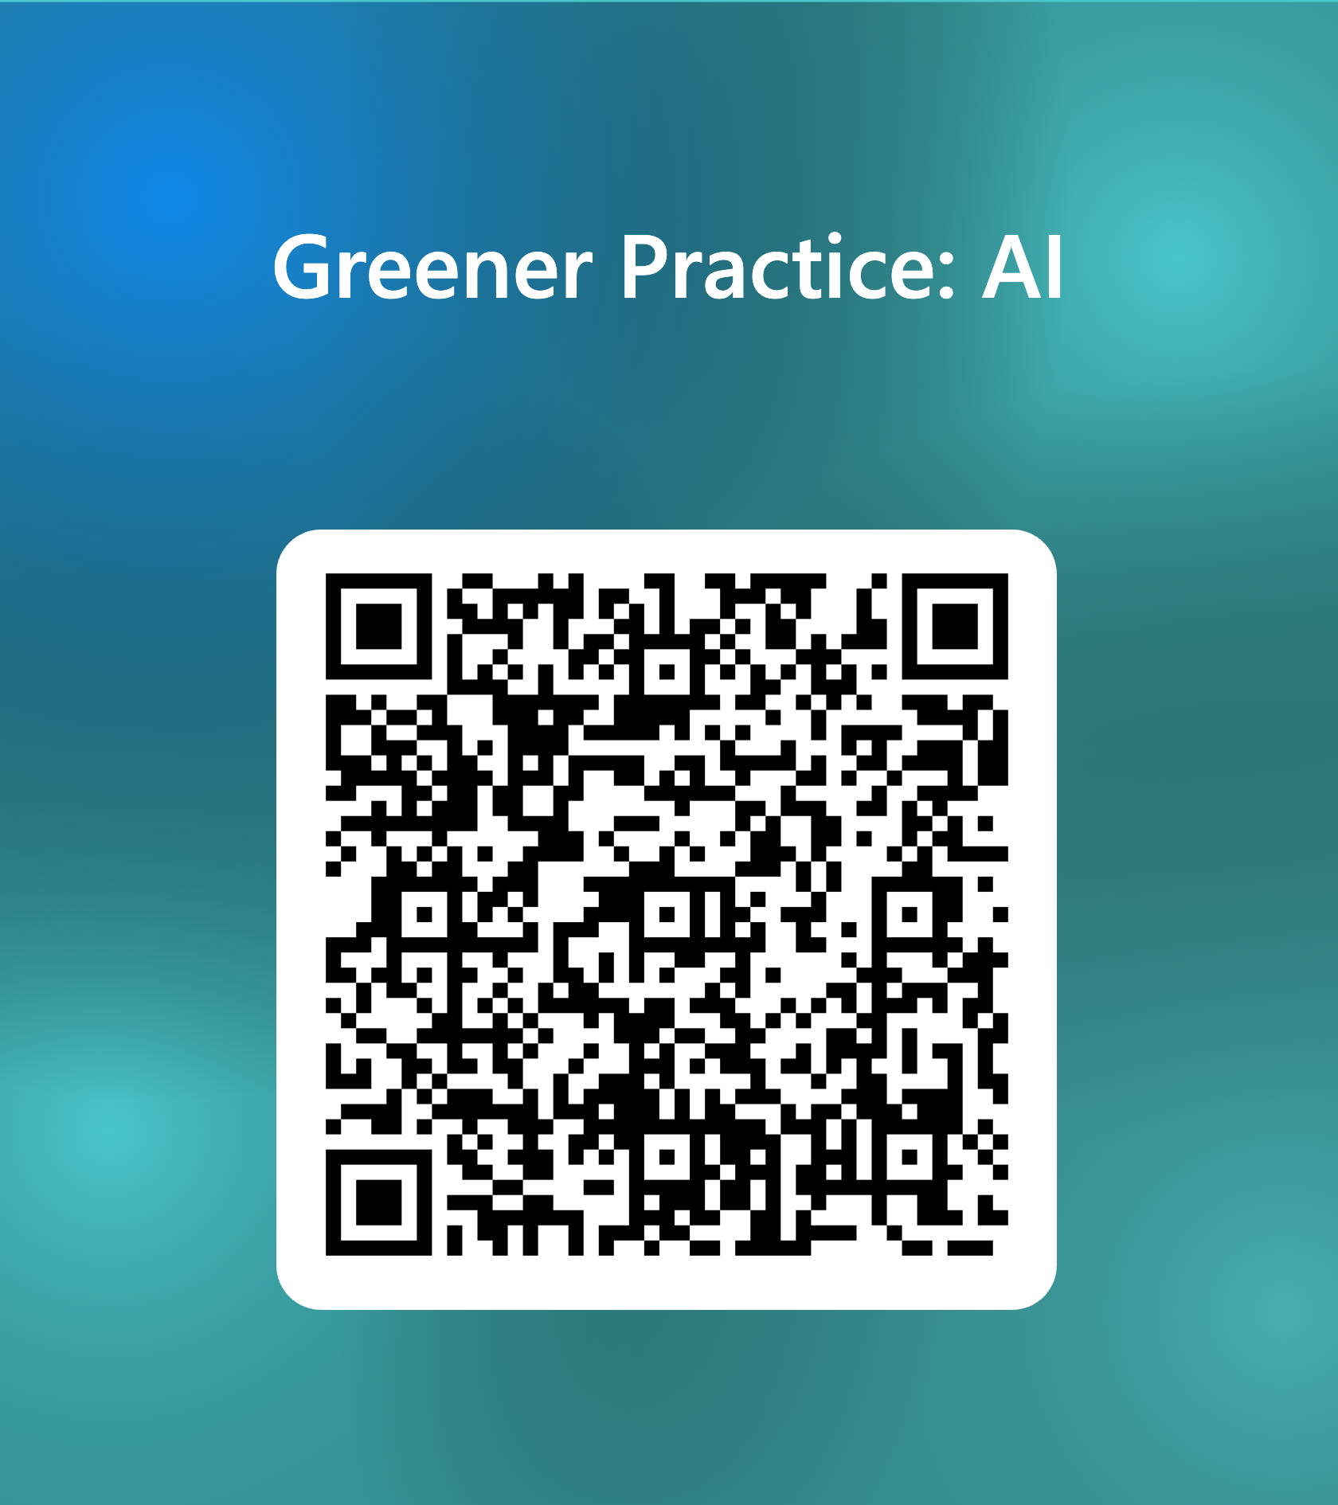
Please take 2 mins to leave us some feedback

Slide 18
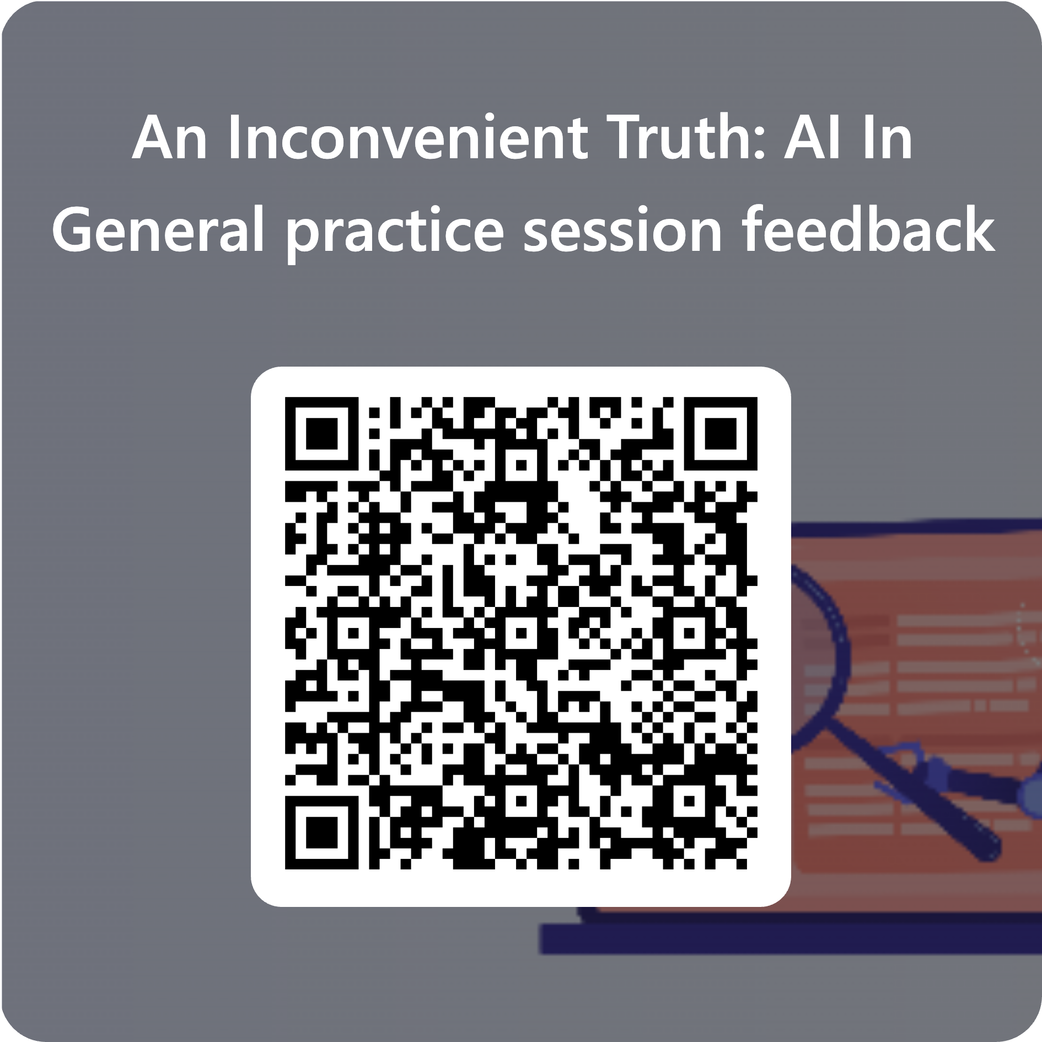
YOUR FEEDBACK MATTERS
Thank you for leaving some feedback- it helps me to improve my work.
Scan to share your feedback
Dr Ben Lees | ben.lees@nhs.net

