Slide 1
Beat the Heat
Christelle Blunden MRCGP
drchristelleblunden@googlemail.com

Slide 2
Initial networking
- Led by Southampton Climate Action Network
-Council/University/
Businesses/
Emergency Planning
-Health challenges of heatwaves
-Infrastructure challenges
-Businesses, schools

Slide 3
Primary Care Challenges
Chronic disease and vulnerability
Medication and vulnerability
Housing and vulnerability
Increased incidence of heat-related illness
NHS infrastructure design

Slide 4
What resources exist
WHO
https://www.who.int/publications/i/item/9789289071918
UKHSA
https://www.gov.uk/guidance/adverse-weather-and-health-plan
Society for Acute Medicine
https://www.acutemedicine.org.uk/wp-content/uploads/SAM-Hot-Weather-Health-Plan-2025.pdf

Slide 5
What can practices/ICBs/Greener
GP leads do?
- Educate clinicians on heat and health challenges
- Educate patients using consultations, chronic disease checks, medication reviews
- Heatwave alerts https://weather.metoffice.gov.uk/warnings-and-advice/seasonal-advice/heat-health-alert-servicewaves
Design mjog message for patients in heatwaves at minimum signposting NHS advice https://www.nhs.uk/live-well/seasonal-health/heatwave-how-to-cope-in-hot-weather/
Liaise with allied services such as pharmacists, community independence teams, fire services (safe and well checks), to identify vulnerable patients and signpost them to services e.g. help with home insulation

Slide 6
Influencing the wider conversation
Locally with public health, emergency planning, hospital sustainability teams
Use National Emergency Briefing material as a resource https://www.nebriefing.org/the-film
Consider supporting wider initiatives, grant applications etc for awareness raising, community cool spaces, home insulation advice initiatives, Green Infrastructure planning

Slide 7
Disclaimer and Declaration of Interests
The views expressed by speakers or other third parties are not necessarily those of Greener Practice CIC.
Whilst every effort has been made to ensure that the information and guidance is accurate, it is impossible to predict all the circumstances in which it may be used, and Greener Practice CIC assumes no responsibility or liability for any errors or omissions made in this content.
All presentations are for informational and educational purposes only – content should not be considered applicable to all situations or patients.
The contents do not negate the requirement for comprehensive assessment, liaison, care and management of patients, their families or caregivers.
Greener Practice CIC neither endorses nor accepts responsibility for the content of third party websites or resources included in these presentations.
Declaration of Interests : None to declare
Notes:
Just to mention that we've done our best to ensure the content is accurate to the best of our knowledge and that what we’ll share this evening is to inform and educate, and not a substitute for clinical judgment.

Slide 8
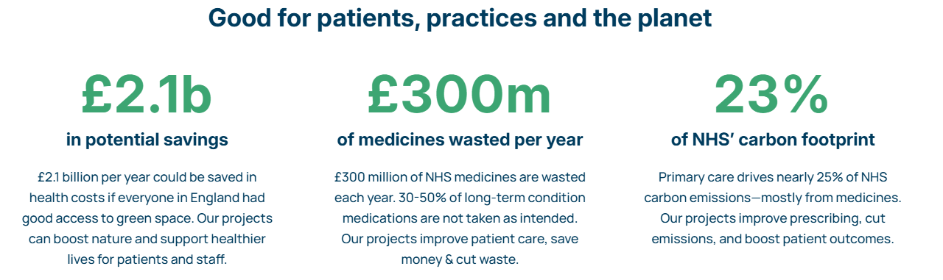
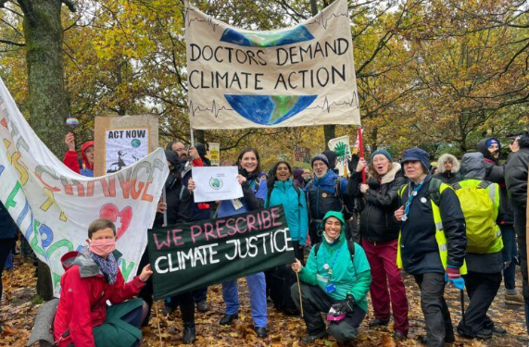
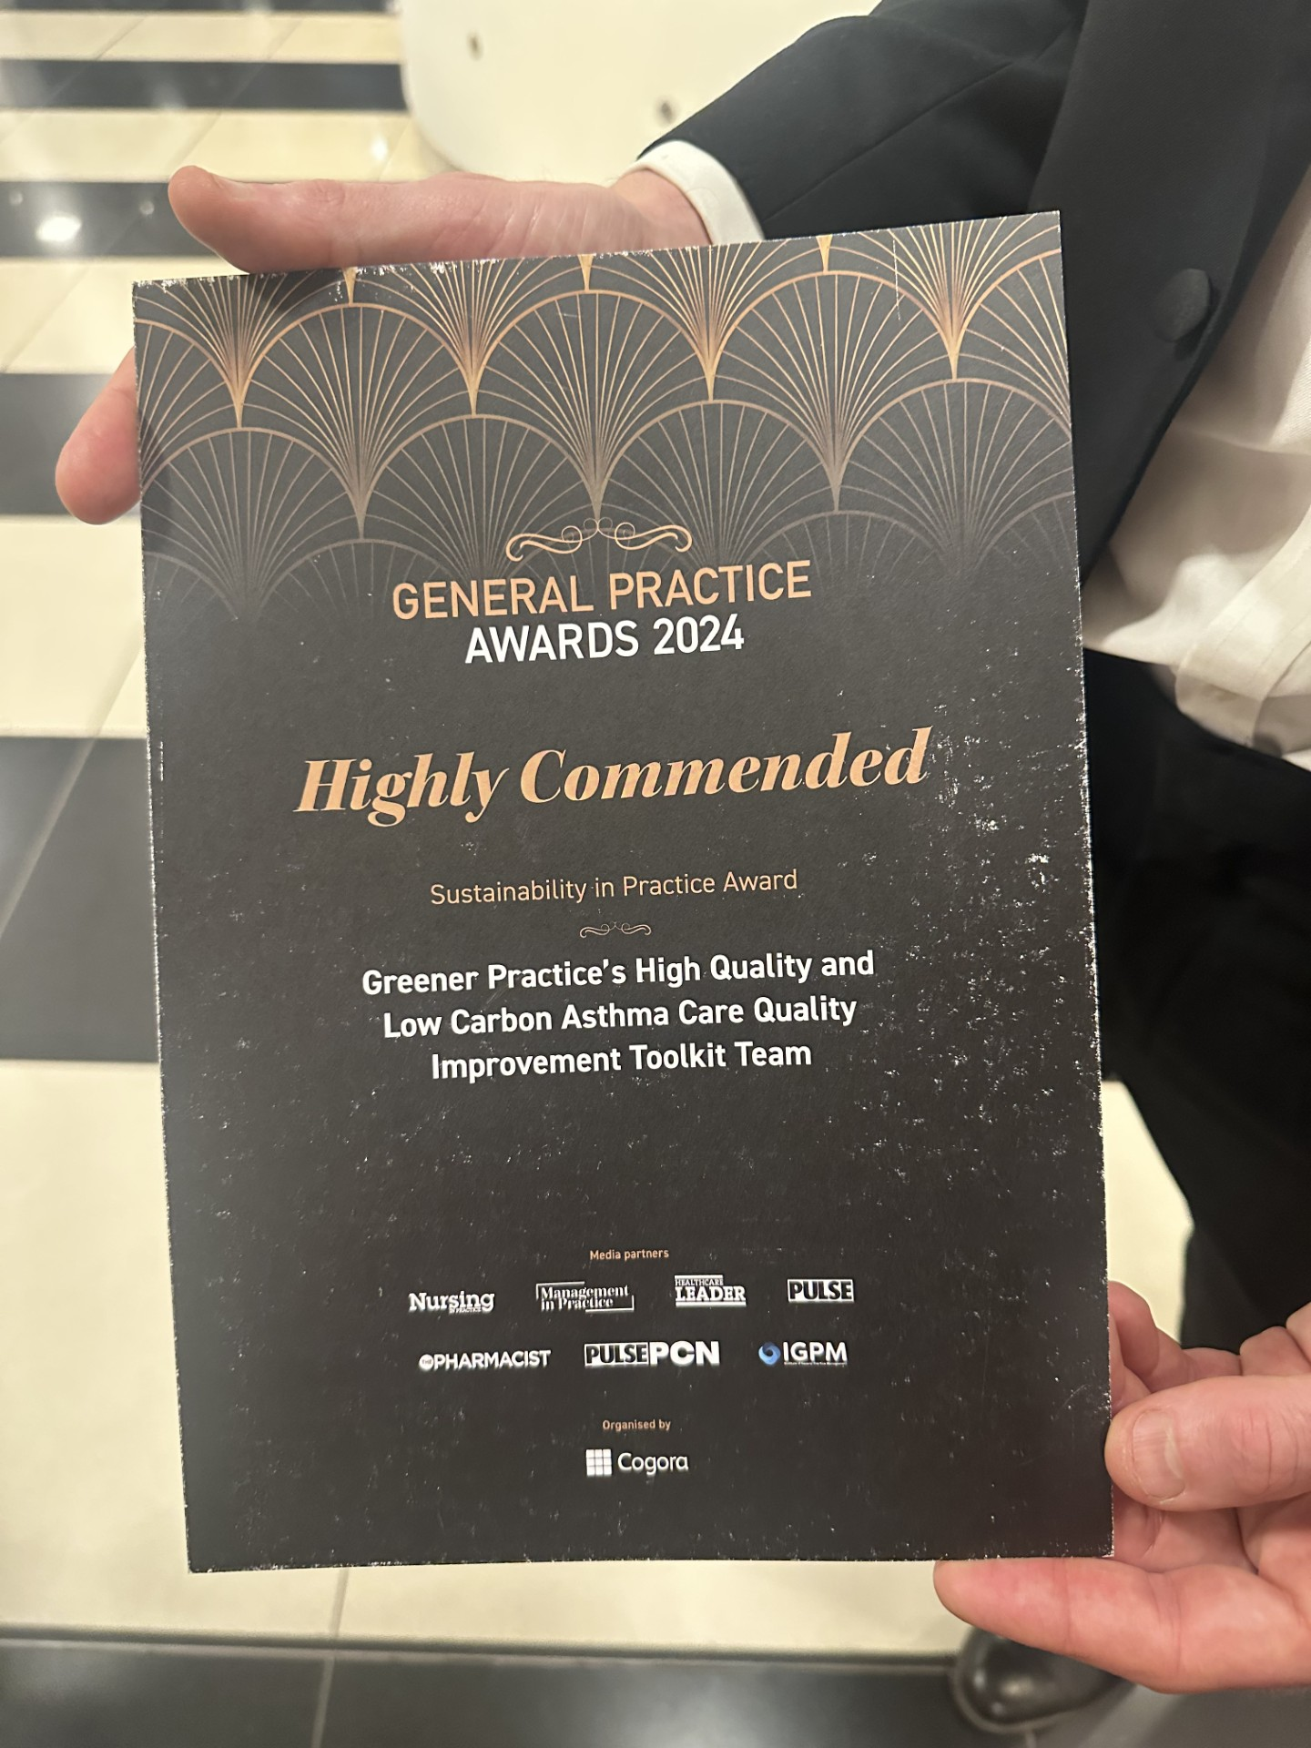
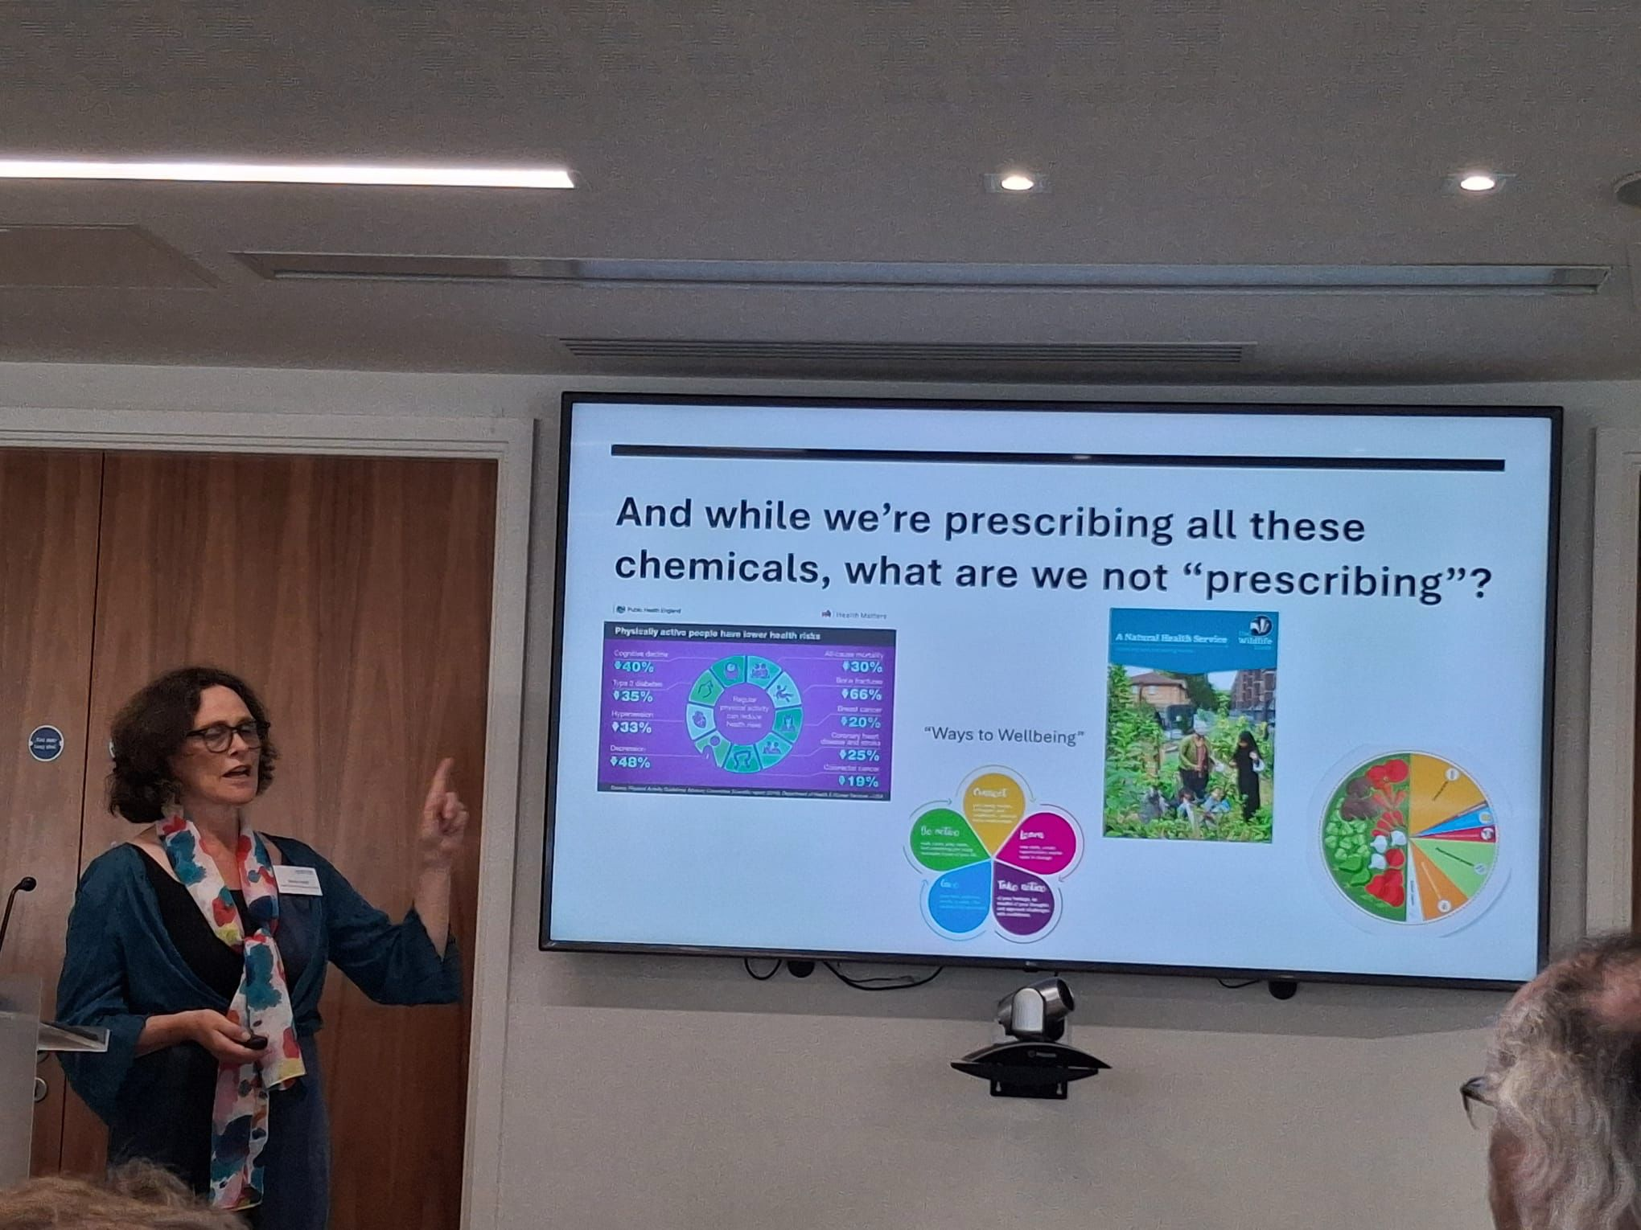
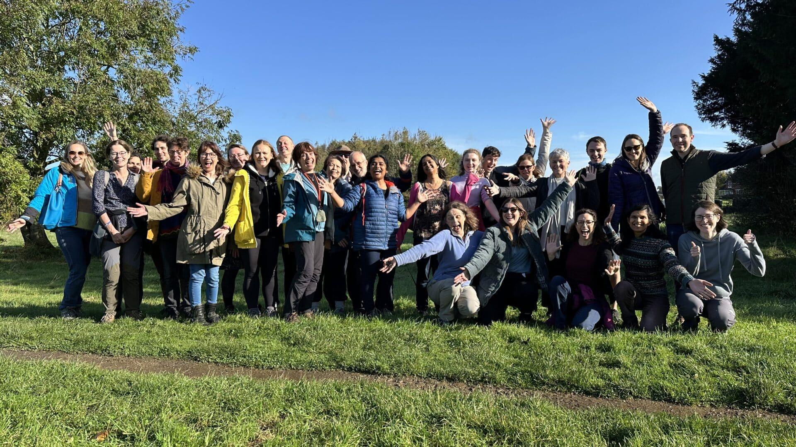
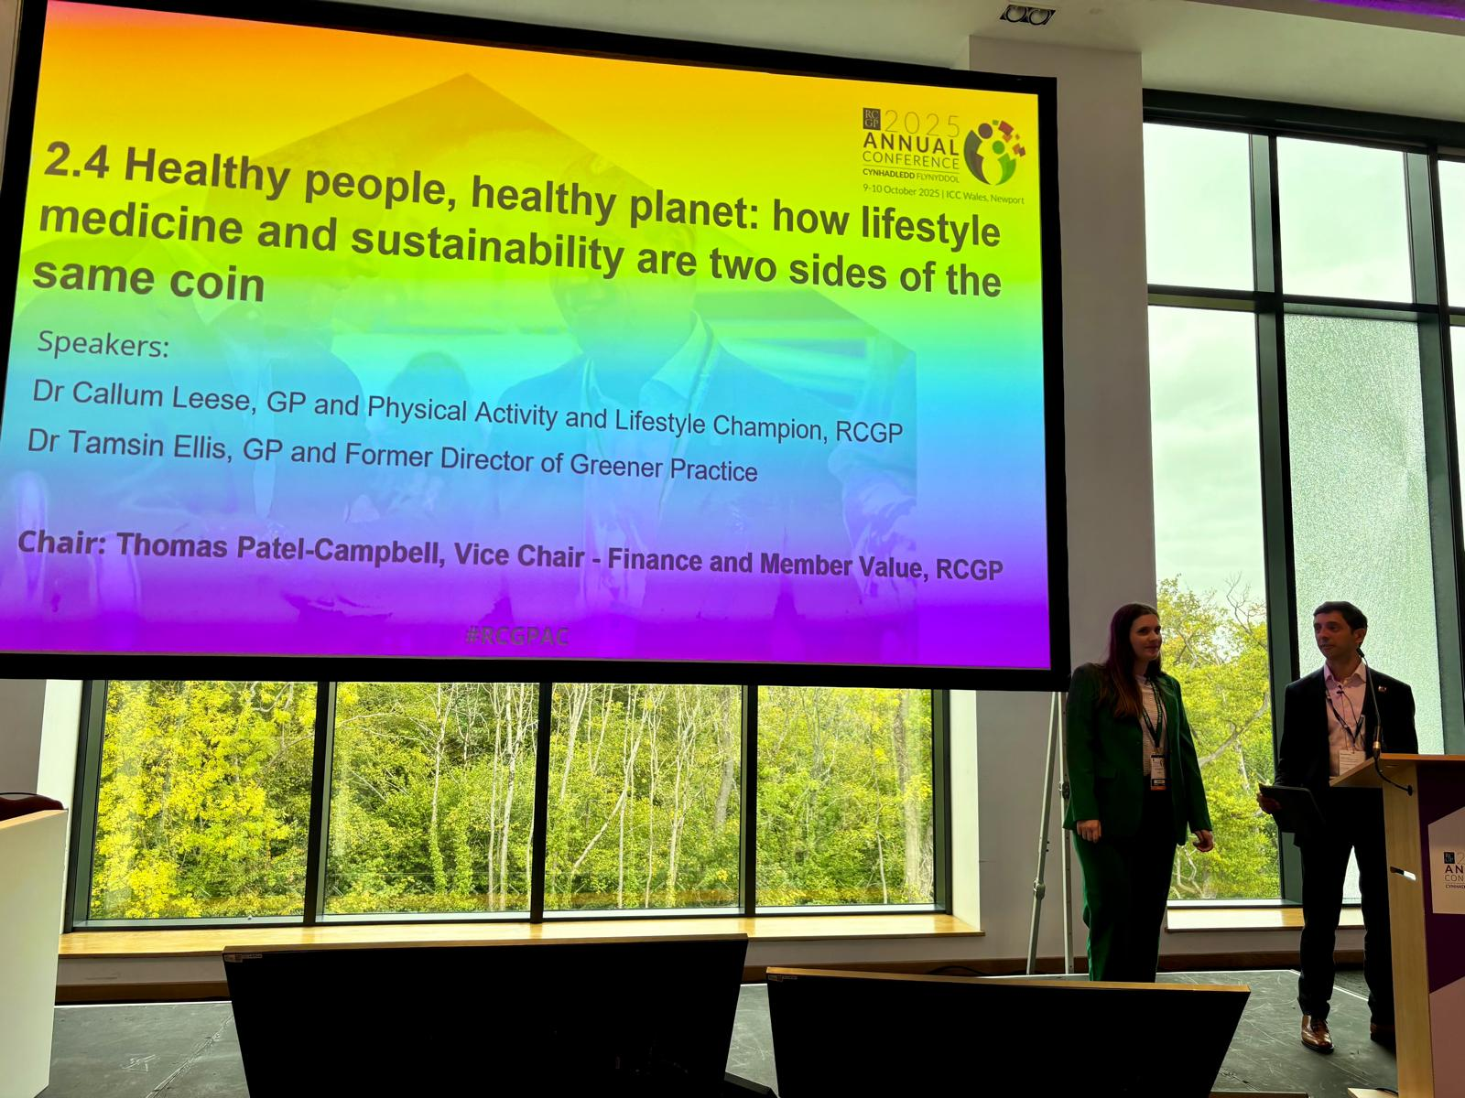
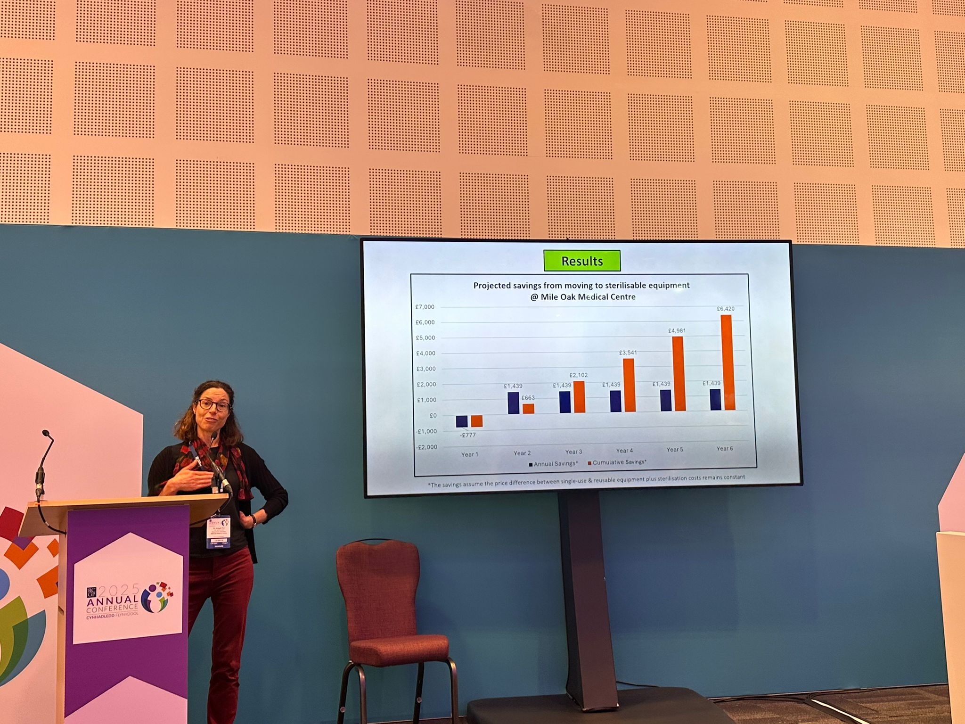
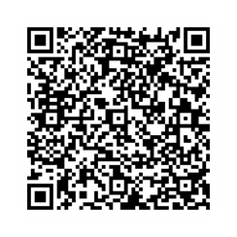
Any Questions?
Scan here to explore our website and join us
✉️ Email:
contact@greenerpractice.com

